Slide 2
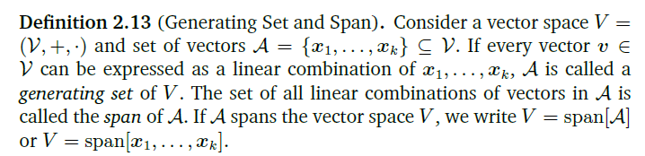
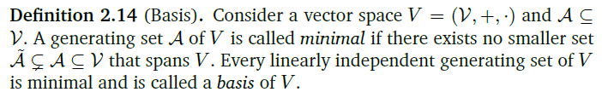

Slide 3
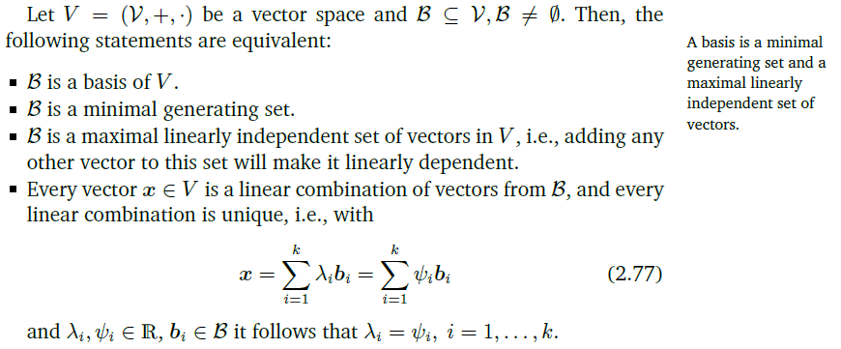

Slide 4
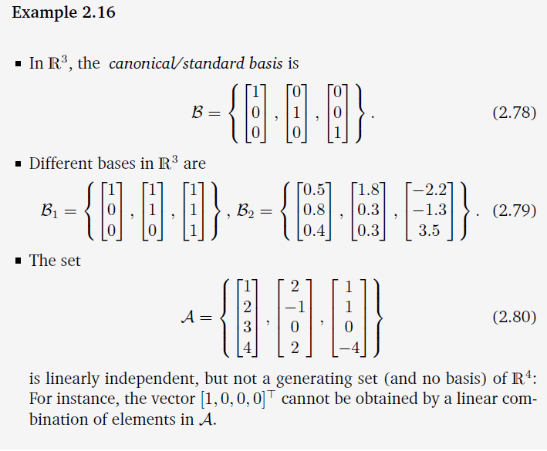

Slide 5
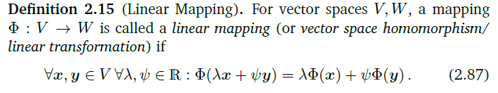
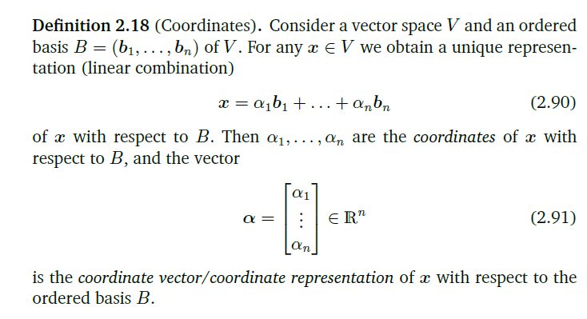

Slide 6
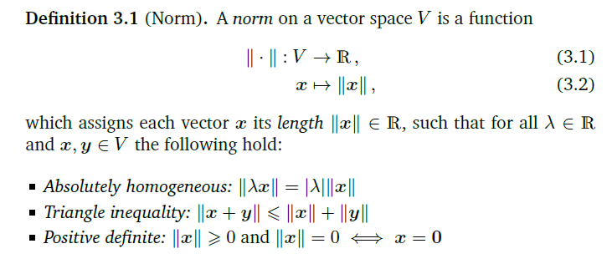

Slide 7
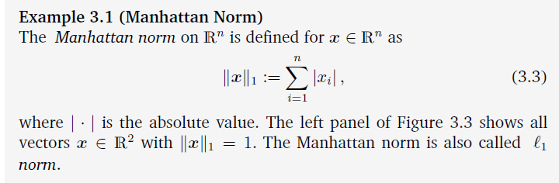
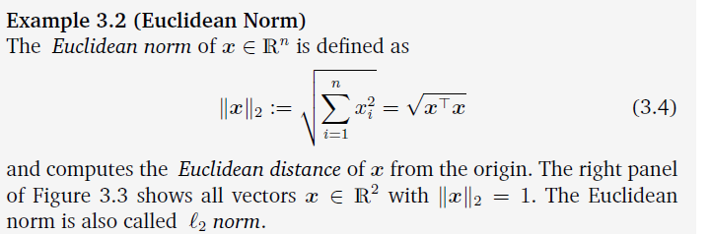
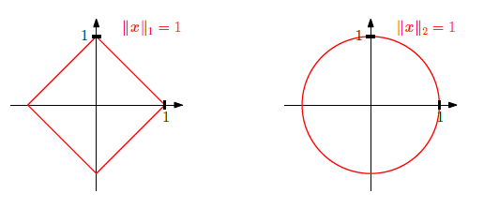

Slide 8
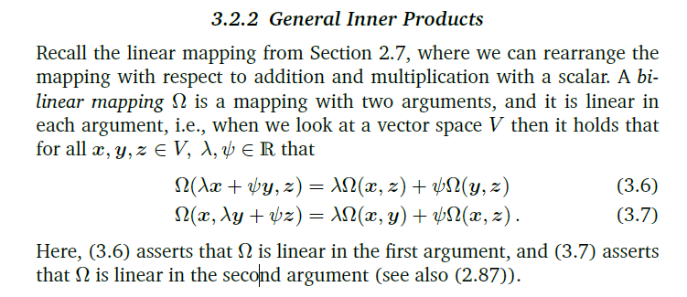
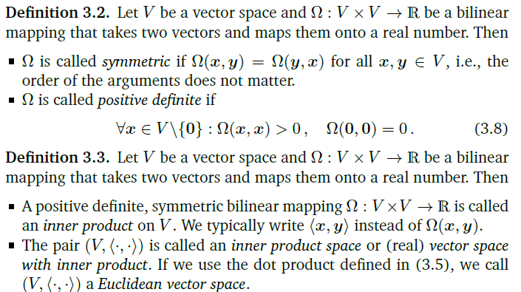

Slide 9
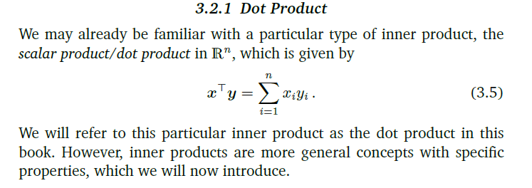
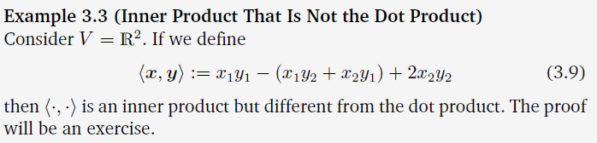

Slide 10
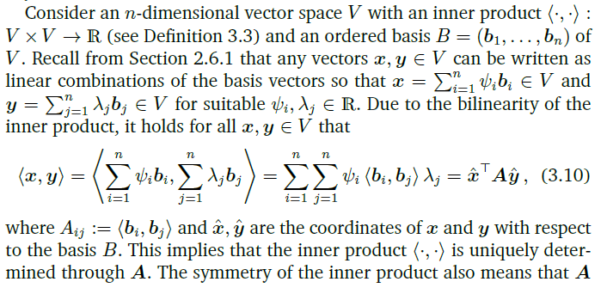
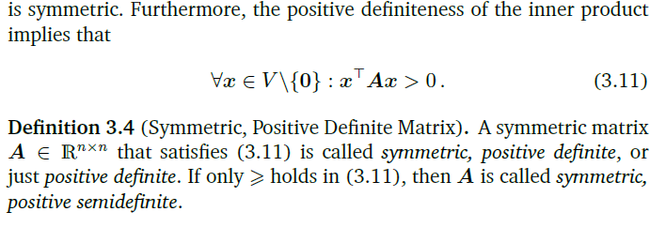

Slide 11
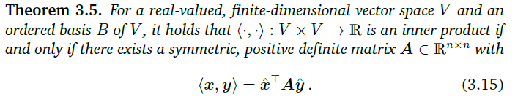

Slide 12
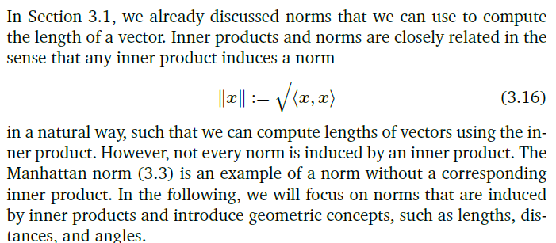
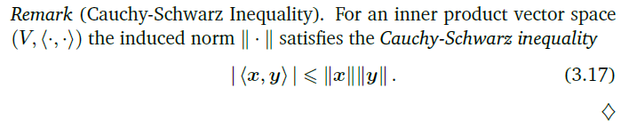

Slide 13
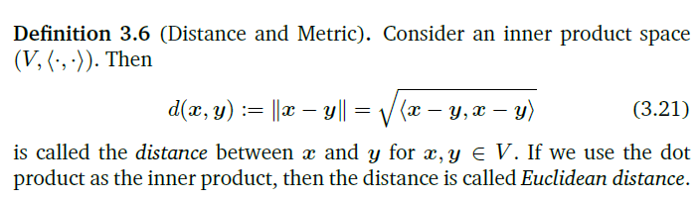


Slide 14
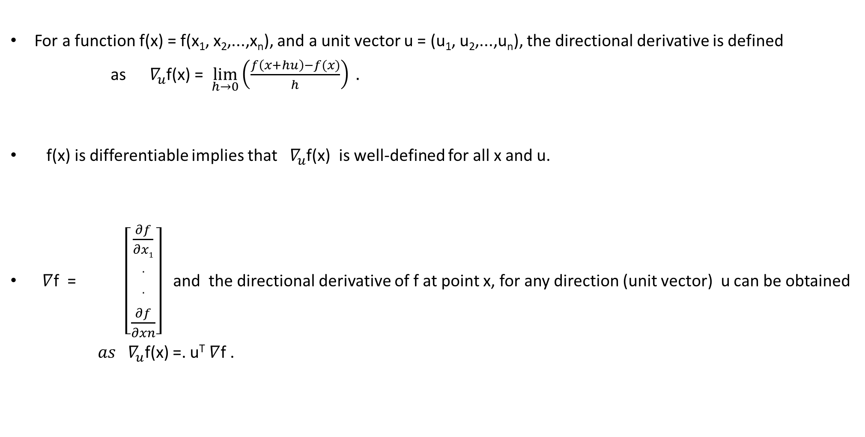
Gradient and Derivatives
For a function f(x) = f(x₁, x₂,...,x_{n}), and a unit vector u = (u₁, u₂,...,u_{n}), the directional derivative is defined
as${ ∇}_{u}$f(x) = $\lim_{h→0}{{\left(\frac{f\left(x+hu\right)−f(x)}{h}\right) . }^{}}$
f(x) is differentiable implies that ${ ∇}_{u}$f(x) is well-defined for all x and u.
$∇$f = $\left[\begin{matrix}\frac{∂f}{∂x1} \\ \begin{aligned}. \\ . \\ \end{aligned} \\ \frac{∂f}{∂xn}\end{matrix}\right]$ and the directional derivative of f at point x, for any direction (unit vector) u can be obtained
${ as ∇}_{u}$f(x) =. u^{T} $∇$f .

Slide 15
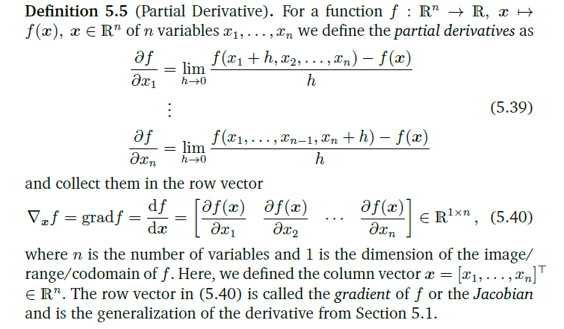

Slide 16
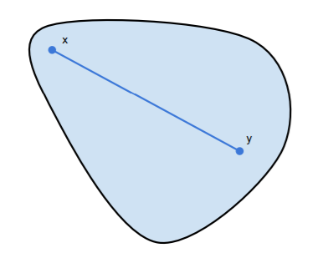
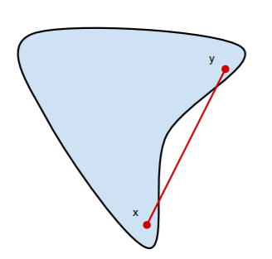
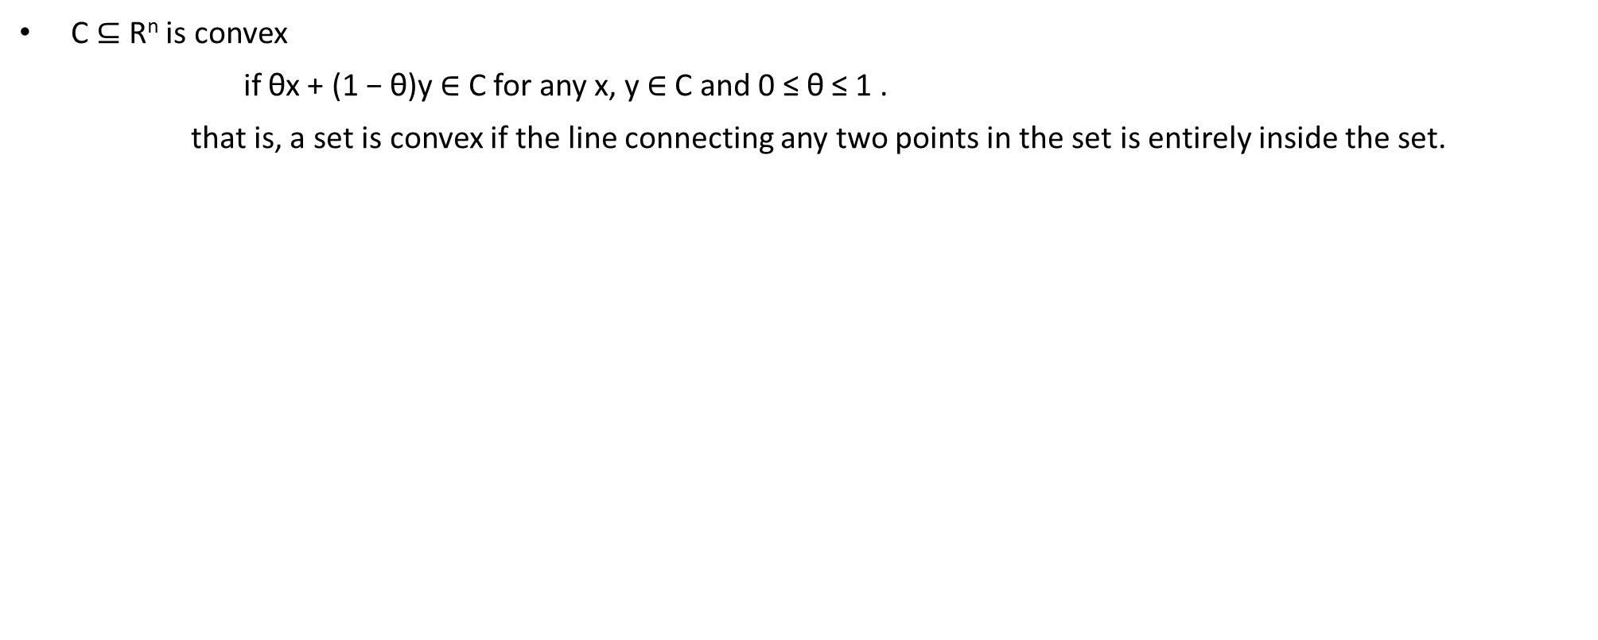
Convex Sets
C ⊆ R^{n} is convex
if θx + (1 − θ)y ∈ C for any x, y ∈ C and 0 ≤ θ ≤ 1 .
that is, a set is convex if the line connecting any two points in the set is entirely inside the set.
1
1
1. Nick Henderson et al., Convex set functions and Problems , 2019 .

Slide 17
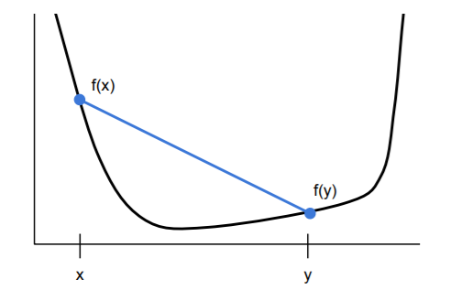
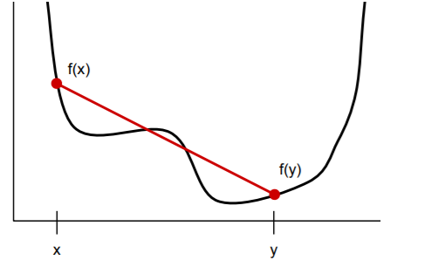
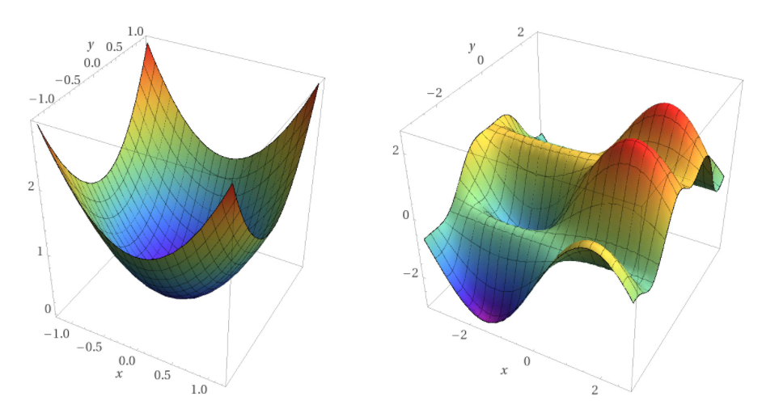
Convex Functions
f : R^{n} → R is convex
if dom (f) (the domain of f) is a convex set,
and if f(θx + (1 − θ)y) ≤ θf(x) + (1 − θ)f(y) for any x, y ∈ dom(f) and 0 ≤ θ ≤ 1 .
that is, the line connecting any two points on the graph of the function stays above the graph.
1
1
1. Nick Henderson et al., Convex set functions and Problems , 2019 .

Slide 18
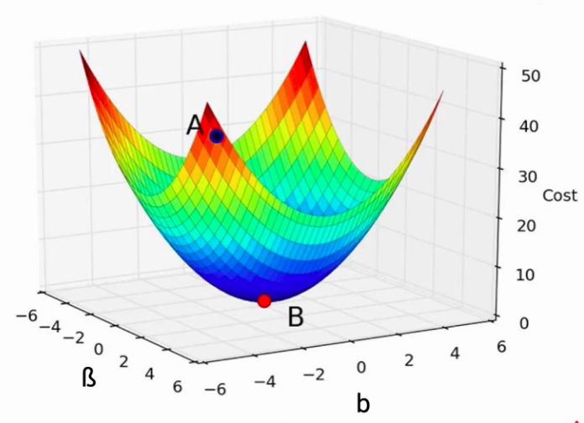
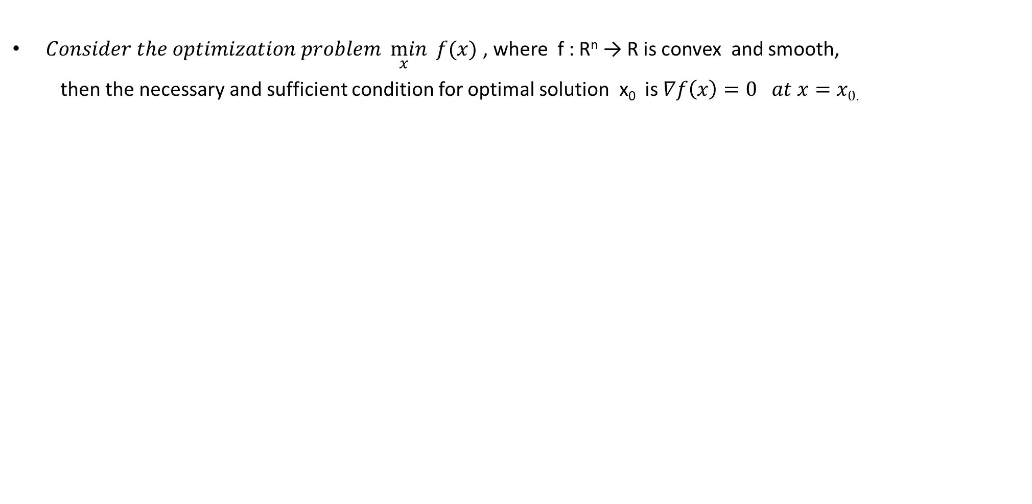
Unconstrained Convex Optimization
$Consider the optimization problem\min_{x}{f(x)}$ , where f : R^{n} → R is convex and smooth,
then the necessary and sufficient condition for optimal solution x₀ is $∇f\left(x\right)=0 at x=x0$.
https://www.cs.utah.edu/~jeffp/IDABook/T6-GD.pdf

